Slide 1
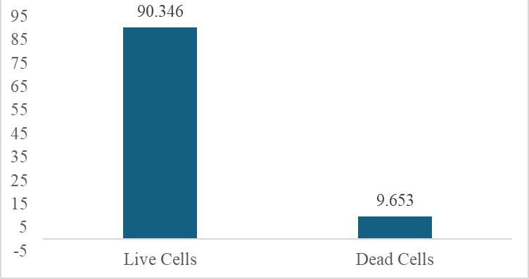
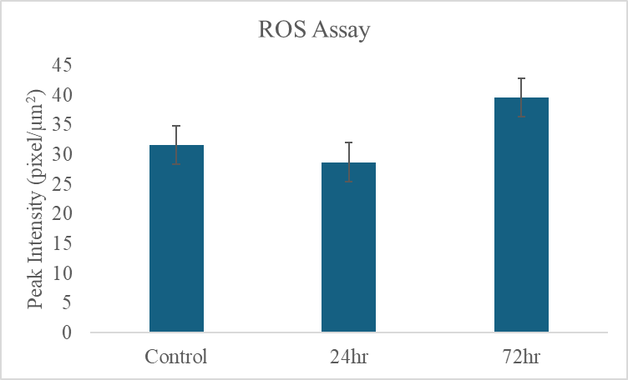
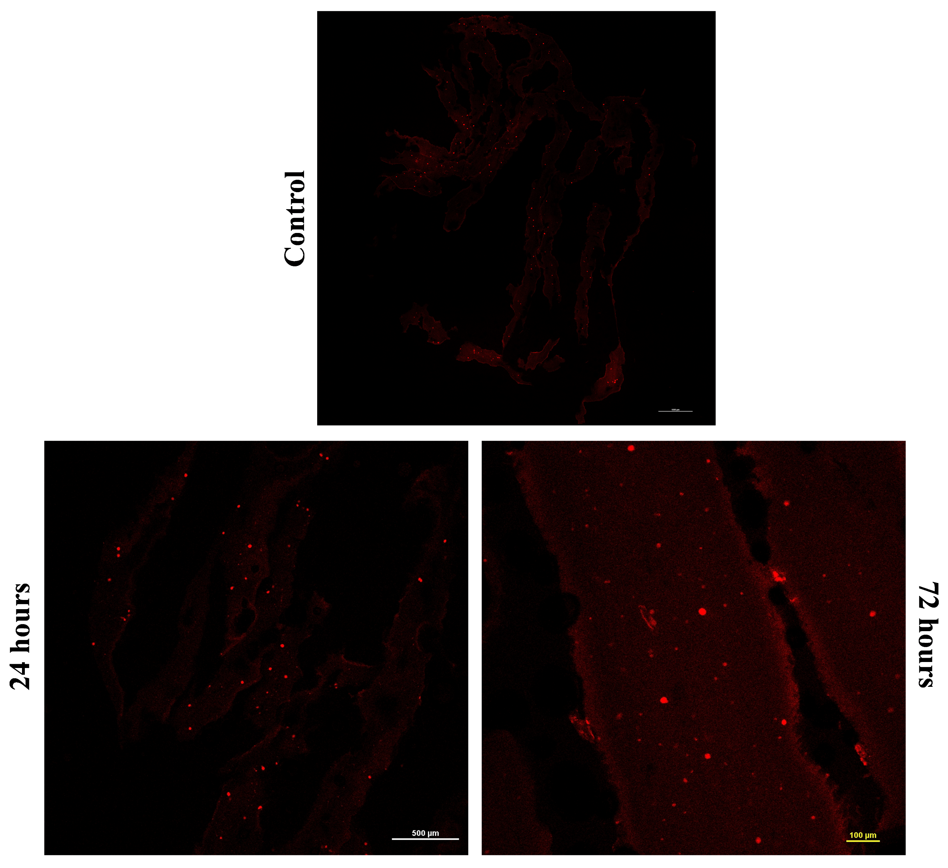
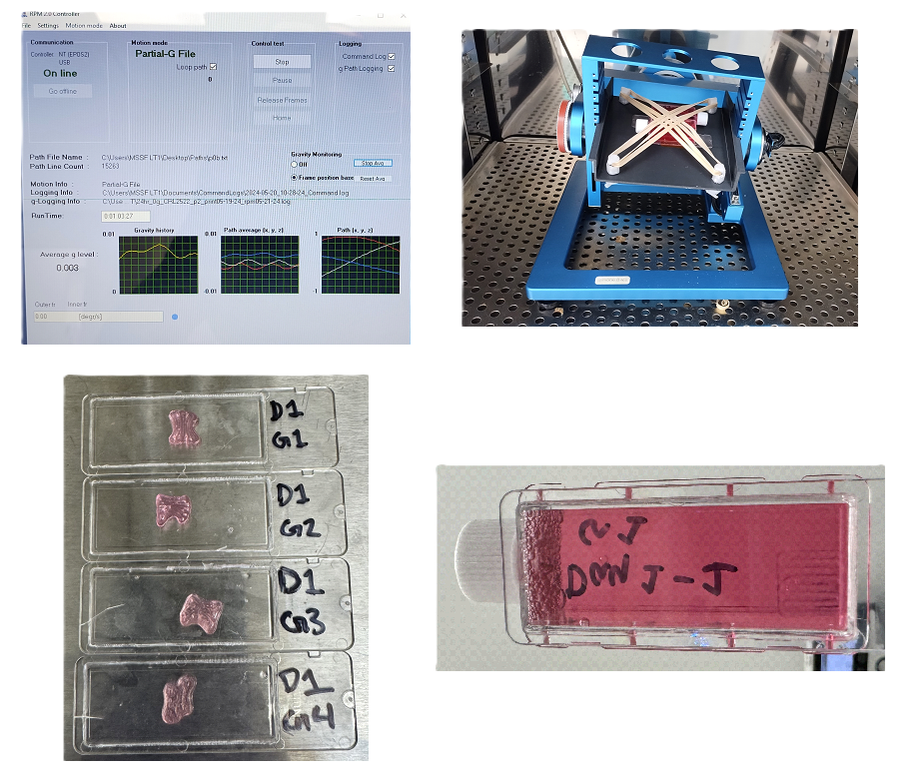
Impact of Microgravity Environment on Bioprinted Cardiac Tissue Constructs
Caleb Phillips, Sampada Koirala, Bela Perdomo, Isscca Hall-Burns, Kunal Mitra
Biomedical Engineering, Florida Tech
Introduction
Results
Microgravity exerts considerable stress on living organisms during spaceflight, disrupting key cellular processes such as cytoskeletal organization, proliferation, and apoptosis. Opportunities to study the effects of gravity variations through space flights are limited due to high costs and the inability to repeat experiments consistently. Therefore, microgravity simulators are developed to study cellular-level effects similar to those experienced during or after space travel. This unique environment particularly affects endothelial cells, potentially triggering a hibernation-like state that slows their growth and contributes to vascular dysfunction [1, 2]. Most culture systems used to study the effects of microgravity are limited by the 2D confines of the culture dish. This limits the proliferation and differentiation of cells in 2D, which could potentially restrict cell-cell interactions that are important for developing the level of organization in tissue obtained in vivo. The use of simulated microgravity and 3D bioprinted models is beneficial for advancing scientific research and astronaut health during long-duration mission. these approaches enable the investigation of cellular responses like cytoskeletal reorganization, proliferation, and apoptosis in space environments. Physiologically relevant tissue models that mimic in vivo structures will offer insights as how microgravity affects cellular organization and function while also supporting personalized health monitoring, regenerative therapies, and tissue repair for astronauts in space.
Increased reactive oxygen species (ROS) generation manifesting oxidative stress can be observed in the bioprinted constructs exposed to simulated microgravity, resulting in cellular dysfunction.
- Figure 1 shows the cells are more stressed at 24hr and 72hr compared to control during exposure to simulated microgravity.
- Figure 2 shows the corresponding confocal images of control, 24hr, 48hr, and 72hrs as obtained by embedding the tissue constructs in Tissue-tek and sectioning thin samples (5μm) followed by incubation using Dihydroethidium (DHE) (Invitrogen, D11347).
Figure 3 shows the cellular viability of the bioprinted tissue constructs after 10 days demonstrating a viable model for long duration space studies.
Figure 3: Cellular viability after 10 days of bioprinting (%).
Conclusion
This study highlights the impact of simulated microgravity resulting in increased oxidative stress manifested in bioprinted cardiac tissue constructs. The results demonstrate that oxidative stress increases with time. This could lead to vascular dysfunction due to elevated reactive oxygen species (ROS) generation. These findings demonstrate the importance of using 3D bioprinted cardiac tissue constructs as a model for investigating the underlying biochemical mechanisms of vascular dysfunction in microgravity environment. This research will lead the way for understanding of the mechanisms and pathways for vascular dysfunction under stress as encountered in space. Further research is also needed to develop countermeasures to prevent vascular dysfunction as expected in space missions.
Future work involves use of human-induced pluripotent stem cells (iPSCs) for development of cardiovascular organoids derived from patients’ cells, which can enable a better-precise and personalized medicine approach in the disease modeling process.
Objectives
Optimization of the 3D bioprinted cardiac tissue constructs by assessing cellular viability over extended period of time.
Investigate the impact of simulated microgravity induced oxidative stress in 3D bioprinted cardiac tissue constructs as a function of time by conducting biochemical analysis.
Figure 1: Oxidative stress as a function of time.
Experimental Setup
A CellInk BioX6 3D Bioprinter has been used to print a vascular tissue construct having a rectilinear grid pattern with channels for perfusion. These constructs were exposed to a gravite microgravity simulator for a period of 24 to 72 hours.
References
1. Sokolovskaya, A. A., Ignashkova, T. I., Bochenkova, A. V., Moskovtsev, A. A., Baranov, V. M., & Kubatiev, A. A. (2014). Effects of simulated microgravity on cell cycle in human endothelial cells. Acta astronautica, 99, 16-23.
2. Vion, A. C., Ramkhelawon, B., Loyer, X., Chironi, G., Devue, C., Loirand, G., ... & Boulanger, C. M. (2013). Shear stress regulates endothelial microparticle release. Circulation research, 112(10), 1323-1333.
Acknowledgements
Figure 2: Confocal images showing variation in oxidative stress.
The authors would like to acknowledge funding support from National Science Foundation – Grant Number CBET 2317757.

